Slide 1
Building Your Benefits
HEALTH AND WELFARE AND PENSION FUNDS

Slide 2
Table of contents
Health and Welfare Benefits
Health and Welfare Plan of benefits…………………… 24
How the Plan pays benefits………………………………. 25
Preferred provider networks……………………………… 26
Medical benefits…………….………………………………. 27
Dental benefits…………………………………………....... 28
Prescription drug benefits……………………………...... 29
Blood pressure monitoring benefits…………………… 30
Vision benefits……………………………………………..... 31
Hearing benefits…………………………………………..... 32
Member assistance program benefits………………… 33
Family Supplemental benefit…………………….……… 34
Even more benefits…………………………..…………….. 35
Retiree benefits………………………………………………. 36
Summary Plan Description………………………………. 37
Pension Benefits
Pension benefits…………………………………………….. 39
Vesting………………………………………………………….. 40
Commencing your benefit /
Types of benefits offered..................................... 41
Pension benefit payment options………………………. 42
The more you work, the more your benefit…………… 43
Supplemental Lump Sum benefit………………………. 44
Total and Permanent Disability benefit……………….. 45
Summary Plan Description……………………………….. 46
In closing……………………………………………………….. 47
New apprentice training…………………………………….. 3
About us – the Fox Valley Funds ………………………….. 4
Fox Valley Locals of the Chicago District Council…… 5
Review your hours…………………………………………….. 6
Review your hours – quarterly……………………………… 7
Review your hours – anytime………………………………. 8
Participant Dashboard………………………………………. 9
Work jurisdiction………………………………………………10
Know your wages…………………………………………….. 11
We are here for you and your family……………………. 13
We are here for you and your family – in person……. 14
We are here for you and your family – online………… 15
Enrollment
Eligibility and participation………………………………… 17
Let’s get enrolled!................................................... 18
Eligibility
Initial eligibility………………………………………………… 20
To continue eligibility……………………………………….. 21
What if I lose eligibility?......................................... 22

Slide 3
New apprentice training
Today’s Goals:
Complete your enrollment in the Fox Valley Laborers Health & Welfare Fund and the Fox Valley and Vicinity Laborers Pension Fund
Register you for our online Participant Dashboard
Complete a Transfer Request form
Provide you with Fund Office contact information
Provide you with an overview of the benefits a laborer earns

Slide 4
About us – the Fox Valley Funds
The Fox Valley Laborers Funds were established by an Agreement and Declaration between the Laborers International Unions of North America, Locals 582 and 1035, AFL-CIO and the Fox Valley General Contractors Association and the Illinois Road Builders Association, representing the contributing employers, and the Union representing the employees.
The Fox Valley Laborers Health and Welfare Fund was established on October 1, 1961
The Fox Valley and Vicinity Laborers Pension Fund was established on June 1, 1965
The purpose of the Funds is to provide health and welfare and pension benefits to participants covered by collective bargaining agreements between the Union and contributing employers.

Slide 5
Fox Valley Locals of the Chicago District Council
Local 582: Kane and Kendall Counties
Local 1035: Boone and McHenry Counties
2400 Big Timber Road, Suite 112A
Elgin, IL 60124
(847) 741-7430
(847) 741-1622 (fax)
www.local582.us
Business Manager: Michael S. Bivins
Secretary Treasurer: Alberto Alfaro
3819 N. Route 23, Suite A
Marengo, IL 60152
(815) 568-6190
(815) 568-0942 (fax)
www.local1035.org
Business Manager: Brian M. Urso
Secretary Treasurer: Brandon J. Sheahan

Slide 6
Review your hours
You work hard! Every hour you work counts!
Weekly pay
Health & Welfare eligibility
Pension benefit accrual
Check your hours on a regular basis to make sure they are accurately reported by your employers
Keep your weekly check stubs
Keep a log of hours worked
Verify your hours worked via the Participant Dashboard
Verify your hours worked to the Quarterly Status report provided by the Fund Office

Slide 7
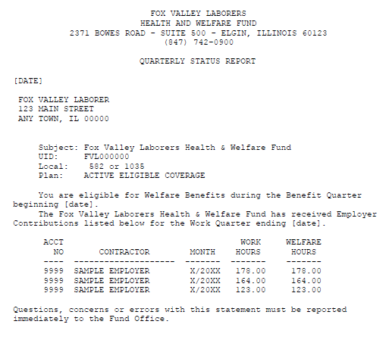
Review your hours - quarterly
Each quarter the Fund Office will send you a Quarterly Status Report reflecting the hours reported on your behalf by your employer(s). Review this report and confirm these hours accurately reflect the hours you worked.
Advise your Employer, Business Agent, and the Fund Office of any discrepancies.
Our team will ensure that the fringe benefit contributions for each hour worked are collected and credited to you.

Slide 8
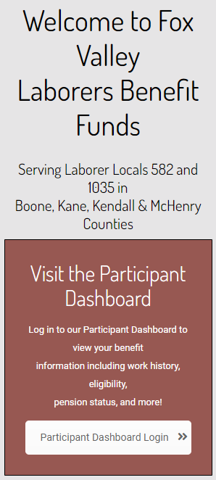
Review your hours - anytime
Don’t want to wait for a paper statement?
Your contribution history can be viewed 24/7/365 on our Participant Dashboard through our website at www.fvlab.com
Contact the Fund Office for access if you haven’t already
been provided your username and password.

Slide 9
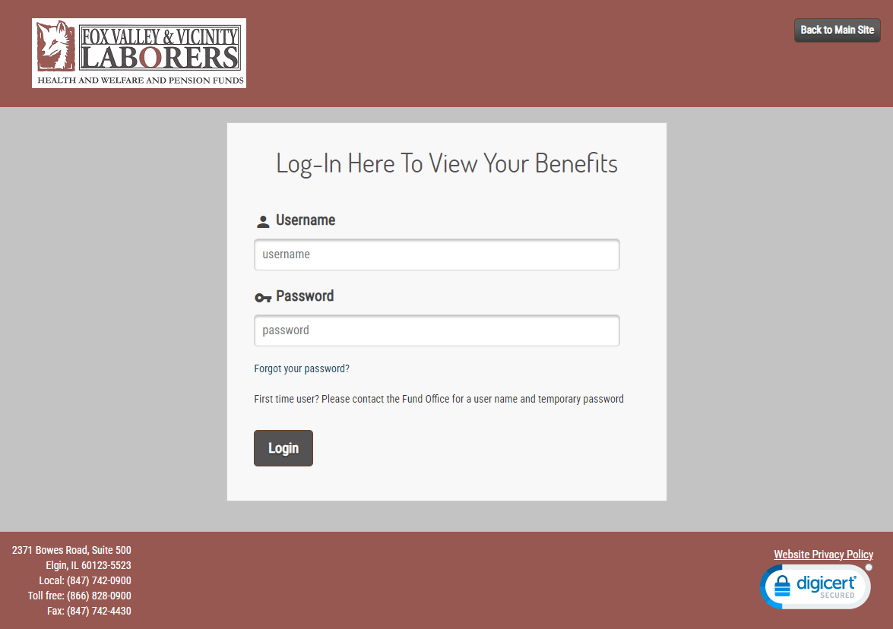
Participant Dashboard
Personal general information
Eligibility status
Review recent insurance claims
Pension credits
Prepare a pension estimate
Submit online forms
Print paper forms

Slide 10
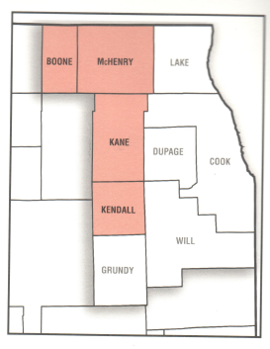
Work jurisdiction
Working outside of the Chicagoland area?
Please keep in mind that if you are working outside of the nine Chicagoland counties, your hours could be reported to a different benefit fund office.
Contact the Fox Valley Fund Office or our website www.fvlabs.com/forms page to obtain a Transfer Request and Consent Form. This provides us with the authorization to have your contributions reported to the work jurisdiction (Away Fund) transferred back to the Fox Valley Funds (your Home Fund).

Slide 11
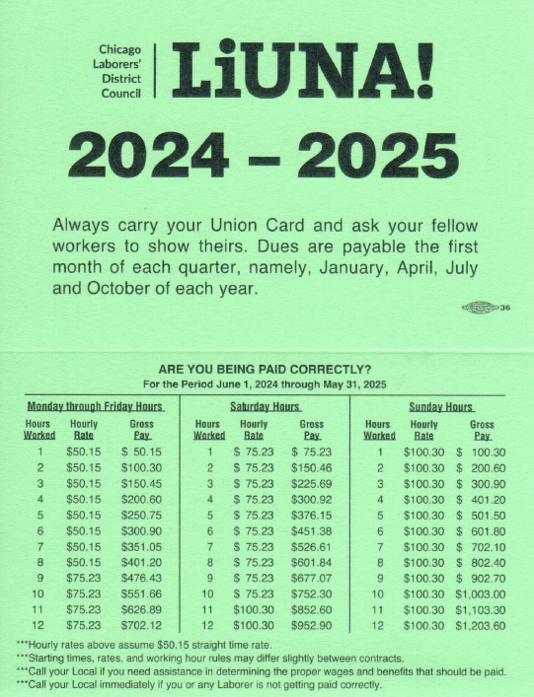
Know your wages
Are you being paid properly? Allocations for wages and benefits are effective June 1st of each year. The rate effective June 1, 2024 is $50.15 per hour.
Contact your Local if you need assistance in determining the proper wages and benefits that should be paid.
Contact your Local immediately if you or any Laborer is not receiving the proper pay!

Slide 12
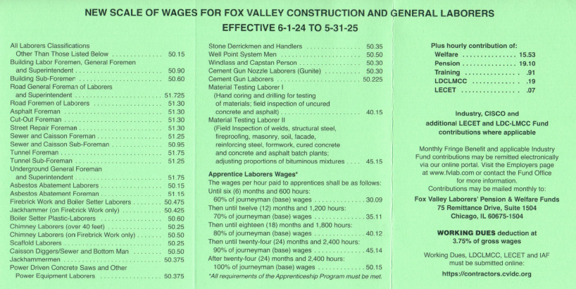
Know your wages

Slide 13
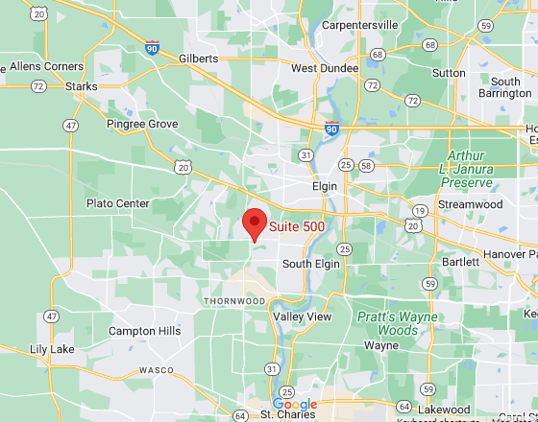
We are here for you and your family
The Fund Office is located at:
2371 Bowes Road, Suite 500
Elgin, IL 60123
Phone: (847) 742-0900
Fax: (847) 742-4430
Customer Service is available Monday through Friday from 8:00 a.m. to 4:30 p.m.
Call or walk-in with your questions.

Slide 14
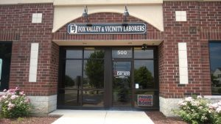
We are here for you and your family – in person
Questions regarding specific matters? Contact our friendly, knowledgeable team members to get your questions answered.
Customer Service: phone menu option #3
Insurance claims
Benefit coverage
Change of address
COBRA election (continuation of insurance coverage)
Pension Department: phone menu option #4
Request a quote
Inquiry on credits
Report a death
Contributions Department: phone menu #5
Unreported hours
Transfer requests

Slide 15
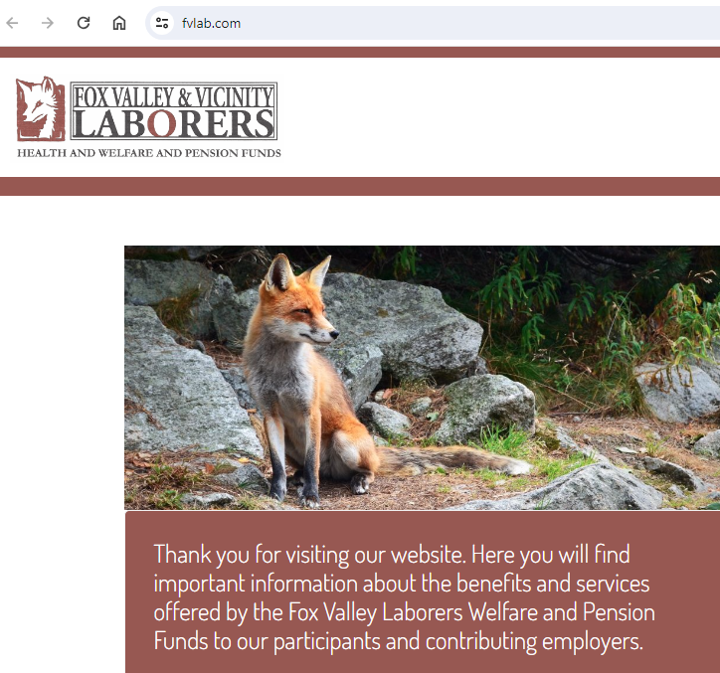
We are here for you and your family - online
Our website is always accessible.
Visit www.fvlab.com for valuable information about your benefit plans, print forms, and more.
Log in to the Participant Dashboard to view your personal data, contribution history, benefit claims paid, and prepare a pension estimate.

Slide 16
Enrollment
HEALTH AND WELFARE AND PENSION FUNDS

Slide 17
Eligibility and participation
The Fox Valley Laborers Health and Welfare Fund offers you coverage for a wide range of benefits, including medical, dental, prescription drug, vision, hearing, member assistance program, family supplemental, and death and disability benefit.
Who is eligible to participant in the Funds?
You, the laborer
Your legally married spouse
Dependent children (up to age 26):
your naturally born children
your legally adopted children
your spouse’s naturally born or legally adopted children

Slide 18
Let’s get enrolled!
Complete and submit an enrollment form to let us know about you and your family members. Be sure to include copies of the requested documentation:
birth certificates
marriage certificate
Social Security cards / ITIN letters
Elect beneficiaries for the Welfare and Pension Funds.
Benefits cannot be paid until all documentation is received
Please note: Anytime you experience any of the following life changes, we will need an updated enrollment form to be sure benefits are paid properly:
Married
Divorced
Have or adopted a child
If you gain or lose other health insurance

Slide 19
Eligibility
HEALTH AND WELFARE AND PENSION FUNDS

Slide 20
Initial eligibility
The Fund must receive contributions from your employer for 300 or more hours of work during a Contribution Quarter before your coverage can begin. Your coverage will begin on the first day of the corresponding Benefit Quarter after the Fund receives the contributions.
OR
The Fund must receive contributions from your employer for 500 or more hours of work during a consecutive six-month period before your coverage can begin. Your coverage will begin on the first day of the month after the Fund receives the contributions.
Contribution Quarter Benefit Quarter
August / September / October January / February / March
November / December / January April / May / June
February / March / April July / August / September
May / June / July October / November / December

Slide 21
To continue eligibility
The Fund must receive contributions from your employer for 270 or more hours of work during a Contribution Quarter (see chart on previous slide).
OR
The Fund must receive 800 or more hours of work in a 12-month period, as follow:
12-Month Period Benefit Quarter
November through October January / February / March
February through January April / May / June
May through April July / August / September
August through July October / November / December

Slide 22
What if I lose eligibility?
If you lose eligibility due to a reduction in work hours, you may elect to purchase COBRA Continuation Coverage for yourself and your eligible dependents for up to 18 months.
Medical only or full coverage (medical / dental / vision) is available.
The Quarterly Status Report will provide additional details for continuing coverage. This report will also show any credit, if applicable, earned to offset the monthly premium.
Contact the Fund Office for your specific situation.

Slide 23
Health and Welfare
Benefits
HEALTH AND WELFARE AND PENSION FUNDS

Slide 24
Health and Welfare Plan of benefits
The Fund provides the following coverage for you and your eligibility dependents:
Medical
Dental
Prescription Drug
Vision
Hearing
Member Assistance Program
Family Supplemental
Loss of Time
Death and Accidental Dismemberment
Retiree Coverage

Slide 25
How the Plan pays benefits
Annual Deductible: $150 per person
$400 per family
Co-Insurance: After deductible, Plan pays:
PPO Providers 90%; you pay 10%
Non-PPO Providers 80%; you pay 20%
Annual Out-of-Pocket Maximum: $1,500 per person, plus deductible

Slide 26
Preferred provider networks
Participating in the following discount networks and programs to provide the most competitive prices for you:
BlueCross BlueShield
CVS Caremark Prescription Drugs
Dental Network of America
Hello Heart
EPIC Hearing Healthcare
EyeMed Vision
AllOne Health

Slide 27
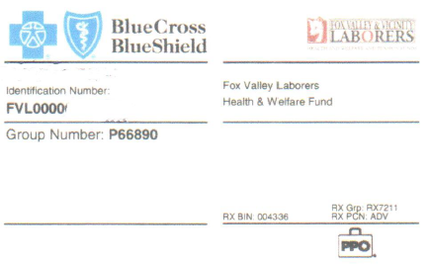
Medical benefits
Just to name a few of the covered items:
Physical exams for you and your dependents
Immunizations
Emergency care
Inpatient hospital services and supplies
Chiropractic care
Physical, occupation, and speech therapy
Skilled nursing facility
Hearing aids
Blood pressure monitoring
Durable medical equipment
Substance abuse benefits
Bariatric surgery
Infertility treatment
Transplant procedures
Case management
Once you’re eligible, watch your mailbox for your identification card

Slide 28
Dental benefits
Coverage and Services: Plan pays 100%, no deductible
Type A for preventive (routine exams and cleaning, etc.)
Plan pays 85%; you pay 15%
Type B & Type C for general and replacement (x-rays, extractions,
filling restorations, etc.)
Type D for orthodontia
Type E for implants
Annual Deductible: Before the Plan pays certain benefits, you must first meet the $50 annual deductible. The deductible applies to Type B, Type C, and Type E Services.
Annual Maximum: An annual maximum of $2,500 per person per calendar year is applicable to Type A, Type B, and Type C Services. Dependent children up to age 18 do not have a maximum.
Lifetime Maximum: Type D (orthodontia) has a $2,000 lifetime maximum benefit, per person
Type E (implants) has a $3,500 lifetime maximum benefit, per person
Ask your provider to submit a pre-treatment dental plan to the Fund Office to determine the level of benefits the Fund will provide.

Slide 29
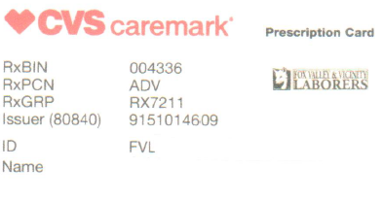
Prescription drug benefits
Up to 30-day supply:
fill at your local retail pharmacy location
$8 copay for generic
$15 copay for name brand
Up to 90-day supply:
(mandatory for maintenance medications)
fill at your local participating CVS, Costco,
or Kroeger retail locations, or by mail, after two retail pharmacy fills (one original and one refill)
$15 copay for generic
$30 copay for name brand
Annual Out-of-Pocket Maximum: $3,000 per person
Present your identification card
at the pharmacy

Slide 30
Blood pressure monitoring benefits
We partnered with Hello Heart because your heart matters.
Take control of your heart health!
Get a free Hello Heart monitor
Track your blood pressure at home
Get medication reminders and see how small changes can have a big impact on your heart
Receive tips and real-time feedback unique to you
Blood pressure, cholesterol, and menopause play a part in your heart health. Sign up today!

Slide 31
Vision benefits
The vision care portion of the Plan helps pay for your eye care needs.
In-network providers provide the most cost-effective benefit. Visit EyeMed.com or call (866) 723-0514 to find a provider in your area. Major retail chains, independent providers, and online suppliers included in the network.
In-network:
Annual Eye Exam: no cost
Annual Maximum: up to $430 per person, per calendar year
(includes lenses / frames or contact lenses)
Out-of-network:
Annual Maximum: up to $300 per person, per calendar year
(includes lenses / frames or contact lenses)
`
Lasik Surgery: up to $1,000 per eye, per person, per lifetime
(coverage for member and spouse only)

Slide 32
Hearing benefits
We have partnered with EPIC Hearing Healthcare to enhance the hearing benefit. You can obtain a hearing exam with a consultation and hearing aids at discounted prices if you use an EPIC Hearing Healthcare network provider.
Hearing exam:
Every 24 months through an EPIC provider at no cost
Hearing aid(s):
$3,000 per ear, every 24 months
Call (866) 956-5400 or visit www.epichearing.com to receive a referral and find a provider in your area.

Slide 33
Member assistance program benefits
We partnered with AllOne Health Company to provide the support you need to:
Improve mental health
Reduce stress
Support whole health
Services are free, confidential, and available to your family household members with 24/7/365 access. Including, but not limited to:
3 mental health sessions per issue, per year
3 life coaching sessions per year
Financial consultations / resources
Legal referrals
Work / life resources and referrals
Medical advocacy

Slide 34
Family Supplemental benefit
Certain medically necessary expenses* may be reimbursable to you if you pay out-of-pocket**.
These eligible expenses include unreimbursed medical, prescription drugs, dental, and vision expenses that you or your dependents incur.
As an example, you may submit a claim for dental or orthodontia benefits that exceed the annual or lifetime maximums.
Length of Service Calendar Year Benefit Amount
Less than 10 years $1,000 per family
10 – 19 years $1,500 per family
20 - 29 years $2,000 per family
30 or more years $2,500 per family
*Expenses must be reimbursable per Internal Revenue Service Medical and
Dental Expenses Publication 502.
**Does not include expenses to meet your deductible or out-of-pocket amount.

Slide 35
Even more benefits
Loss of Time Benefit: The Plan can help you replace part of your income if you become disabled and cannot work. The maximum benefit is $600 per week, up to 26 weeks. In addition, we will credit hours towards your eligibility under the Plan.
Death Benefit: Providing for you and your family in the event of a death.
Death Benefit:
Less than 5 years $20,000
5 – 29 years $40,000
30 or more years $50,000
Dependent Death Benefit:
Spouse $3,000
Child $2,000
Workers’ Compensation: We will credit hours in a Contribution Quarter at a rate of 40 hours per week, up to 1,040 hours per injury. Contact your Local for an attorney referral to assist with your injury matter.
Accidental Dismemberment Benefit: The Plan provides a benefit up to $10,000 if you have a serious injury through accidental means – on or off the job – covering loss of limbs or permanent loss of sight.
Maintain your eligibility for these financially important benefits!

Slide 36
Retiree benefits
As a retiree receiving a pension benefit from the Fox Valley and Vicinity Laborers Pension Fund, you will be eligible for all medical, prescription drugs, dental, vision, hearing, and member assistance program benefits under the Plan when you meet the following eligibility requirements:
You must have at least 15 years of service under the Fox Valley and Vicinity Laborers Pension Fund, with a maximum of 50% of those years granted under reciprocal agreements; AND
Have been eligible for benefits from the Health and Welfare Plan for at least eight Benefit Quarter within the sixteen Benefit Quarters immediately preceding your retirement.

Slide 37
Summary Plan Description
Refer to the Summary Plan Description written in a clear, straight-forward language to serve as an easy-to-use reference guide when you have questions about your health and welfare benefits.

Slide 38
Pension Benefits
HEALTH AND WELFARE AND PENSION FUNDS

Slide 39
Pension benefits
As a participant in the Fox Valley and Vicinity Laborers Pension Fund, you will earn a benefit that will provide you with a monthly income when you stop working at retirement age. This benefit is in addition to your Social Security benefit and your personal savings and investments. The best part is that this doesn’t cost you a thing!
How do you earn a pension? You accrue credits and a benefit for each hour you work performing covered work for a signatory employer.
What’s a credit? You will earn one service credit for the first year of Covered Employment no matter how many hours you work. For each year thereafter, you will earn one year of service credit for each Plan Year during which you work at least 500 hours in Covered Employment.
What’s a Plan Year? Our plan year is from June 1st through May 31st.
Not the same as a calendar year.

Slide 40
Vesting
Once you are fully vested under the Plan, you have a non-forfeitable right to a pension benefit when you retire.
How do I become vested? You are considered vested once you earn at least five years of service (“credits”).
What if I incur a short break in service? You will not receive a credit if you do not work at least 500 hours in a Plan Year (other than your first year).
What if I incur a permanent break in service? If you are not fully vested with five credits, you can lose the amount of service and benefits you’ve accumulated under the Plan if you have five consecutive plan years without earning a credit.
If you are fully vested with a minimum of five years of service, your benefit will still be there when you retire.

Slide 41
Commencing your benefit
Types of benefits offered
You are eligible to collect your pension benefit:
At age 65 or older, with a minimum of five (5) credits / years of service
At age 60 or older, with a minimum of ten (10) credits / years of service
Normal Benefit
Early Benefit
30 and Out
Total and Permanent Disability
When you are ready to retire, complete the pension application and return it to the Fund Office at least 60 days prior to the date you want your pension to begin.

Slide 42
Pension benefit payment options
Single Life Only: Payable for your life only.
Five (5) Year Certain and Life: Payable for your life with 60 guaranteed installments. If you die before receiving 60 payments, your designated beneficiary will receive the remainder of the 60 benefit payments.
Ten (10) Year Certain and Life: Payable for your life with 120 guaranteed installments. If you die before receiving 120 payments, your designated beneficiary will receive the remainder of the 120 benefit payments.
Joint & Survivor: A benefit payable to you with a percentage of your benefit payable to your spouse should you die before your spouse. This benefit is payable in the form of 50%, 75%, or 100% of your benefit amount.
Joint & Survivor with Pop-up: A benefit payable to you with a percentage of your benefit payable to your spouse should you die before your spouse. This benefit is payable in the form of 50%, 75%, or 100% of your benefit amount. However, should your spouse die before you, your benefit will now pop-up to the Single Life Only benefit amount and will be payable for your life only at that increased benefit amount.
Level Income Option: This option adjusts your pension amount before and after you are eligible for Social Security benefits, so that the combined monthly amount you receive remains approximately the same during your retirement. To calculate this benefit, the Fund Office will need a copy of your Social Security benefit statement.

Slide 43
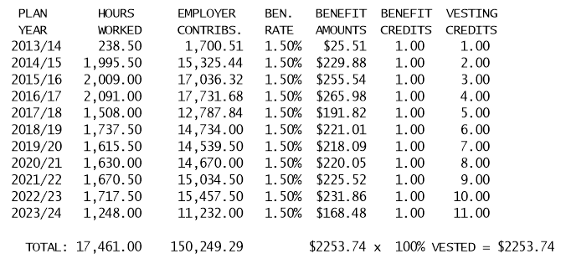
The more you work, the more your benefit
Example: Tom works 11 years in covered employment as a Laborer. His employers have remitted the following hours and contributions on his behalf. His Single Life Only benefit at Normal Retirement Age is calculated below and will be $2,253.74 per month.
Note: Further benefit options will be actuarial reduced based on the benefit elected
Every hour and every dollar is credited towards your benefit!

Slide 44
Supplemental Lump Sum benefit
You are eligible for a one-time payment of $1,000 for each year of Lump Sum Service (minimum of 20 years) during which contributions were made to the Fox Valley and Vicinity Laborers Pension Fund on your behalf. This benefit is increased to $2,000 for each year of Lump Sum Service for the 31st and subsequent years of service. A year of service is defined as at least 500 hours in a Plan Year.
Years of Service Lump Sum Benefit Amount
20 $20,000
21 $21,000
22 $22,000
23 $23,000
24 $24,000
25 $25,000
26 $26,000
27 $27,000
28 $28,000
29 $29,000
30 $30,000
31 $32,000
You must be Active at the time of your retirement. “Active” means you have earned a credit in the Plan Year you begin your pension benefit AND have earned a credit in the two immediately preceding Plan Years.
Although the chart shows the payment you will receive for up to 31 years of service,
the benefit is not capped.
This benefit is also eligible for a rollover into an Individual Retirement Account (IRA).

Slide 45
Total and Permanent Disability benefit
The Plan provides a benefit should you become totally and permanently disabled.
To be eligible for a Total and Permanent Disability Benefit, you must have at least 10 years of service, be Active at the time you are disabled, be considered totally and permanently disabled, and incapable of engaging in any occupation for the remainder of your lifetime based on medical evidence.
This benefit is 80% of your accrued benefit (the benefit you would have received based on Employer Contributions made on your behalf before your disability). The monthly benefit will not be less than $600 per month.
Example:
Tom’s disability benefit would be: $2,253.74 x 80% = $1,802.99 per month
until he reaches his Normal Retirement Age.
“Active” means you have earned a credit in the Plan Year you begin your pension benefit AND have earned a credit in the two immediately preceding Plan Years.

Slide 46
Summary Plan Description
Refer to the Summary Plan Description written in a clear, straight-forward language to serve as an easy-to-use reference guide when you have questions about your pension benefits.

Slide 47
In closing…
We want to extend a warm welcome to you as you begin your career as a Laborer of the Fox Valley Funds!
When it comes to your benefits, please know that we are here for you every step of the way and will help you navigate these benefits.
Our sole purpose at the Fund Office is to service you and your family. Please don’t hesitate to reach out.
Save this presentation for future reference.
Be sure to share this important information with your family.
2024 1101

